Slide 1
Analysis of Russian Alcohol Consumption
Pour Decisions
February 2, 2023

Slide 2
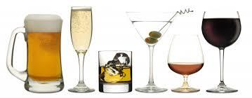
Research Questions
What alcohol type is consumed most in Russia?
How does alcohol consumption change with economic/unemployment changes?
Does preferred alcohol type consumption vary with economic/unemployment conditions?
Can we predict alcohol consumption based on GDP in the future (linear regression)?
Does alcohol consumption per capita change based on region latitude (linear regression)?

Slide 3
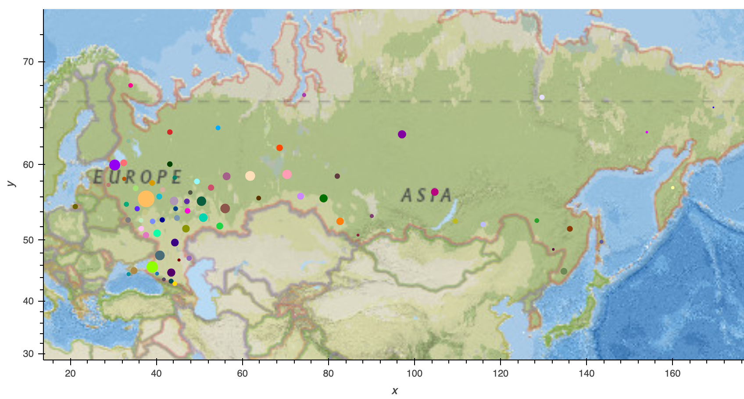
Population of Russian Regions

Slide 4
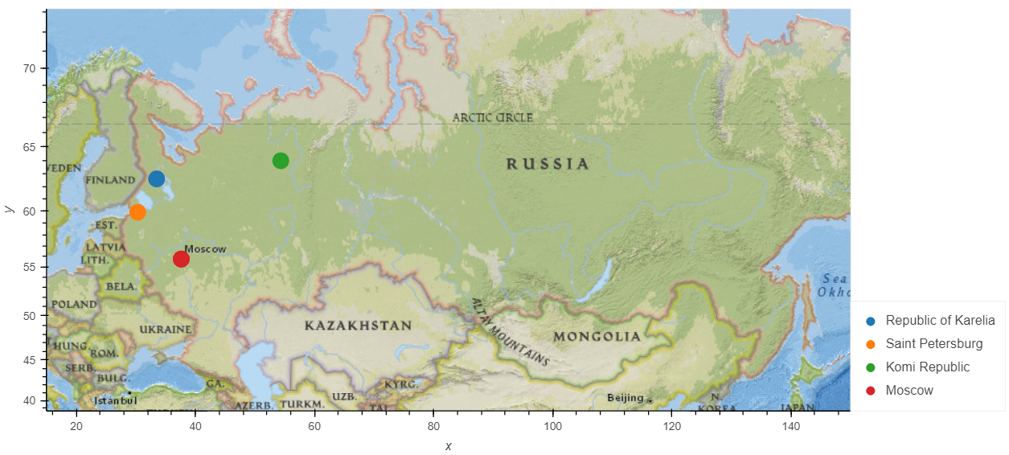
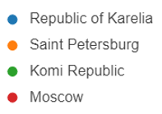
Metadata – Top Consumers by Type
Wine
Beer
Vodka
Champagne & Brandy

Slide 5
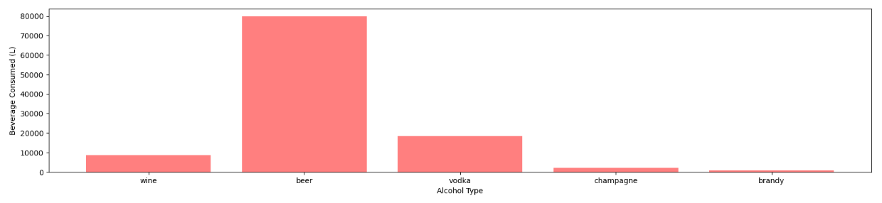
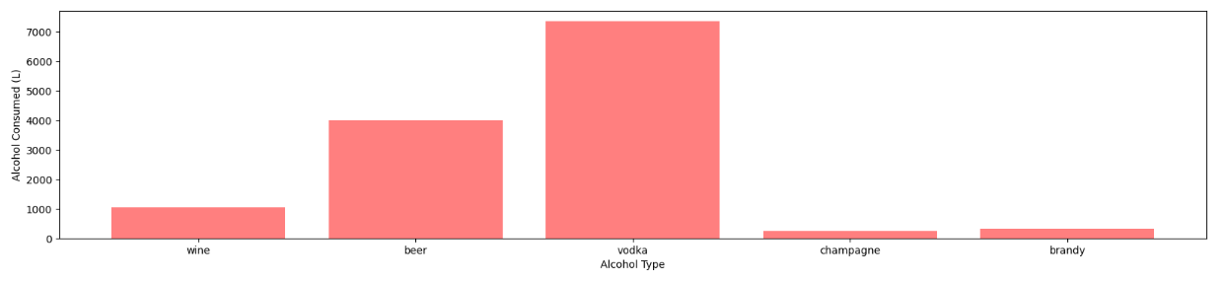
Metadata – Consumption by Type
Total Volume
Alcohol Volume (ABV)

Slide 6
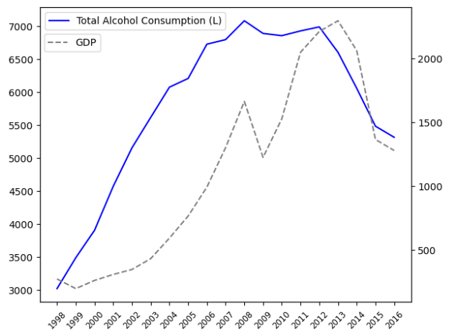
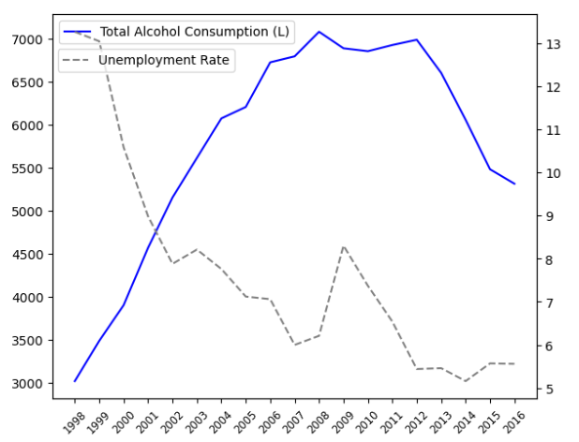
Economic Factors – GDP and Unemployment Rate
Total Alcohol Consumption (L)
Total Alcohol Consumption (L)
Unemployment Rate (%)
GDP in $Billions
Year
Year

Slide 7
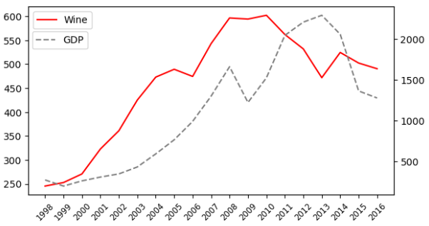
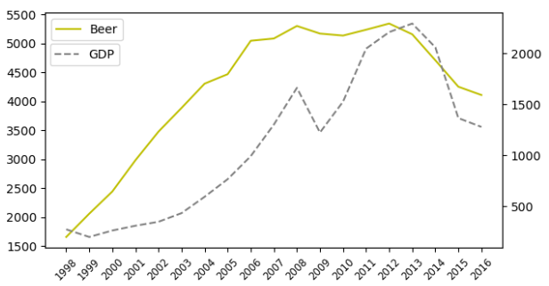
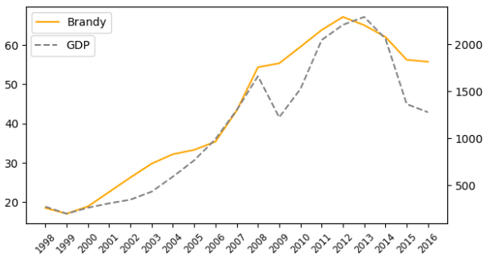
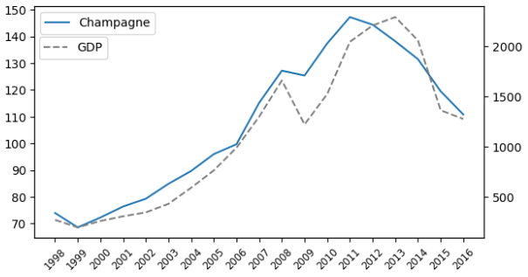
Economic Factors – GDP and Consumption by Type
Wine Consumption (L)
Beer Consumption (L)
GDP in $Billions
GDP in $Billions
Year
Year
Brandy Consumption (L)
GDP in $Billions
GDP in $Billions
Champagne Consumption (L)
Year
Year

Slide 8
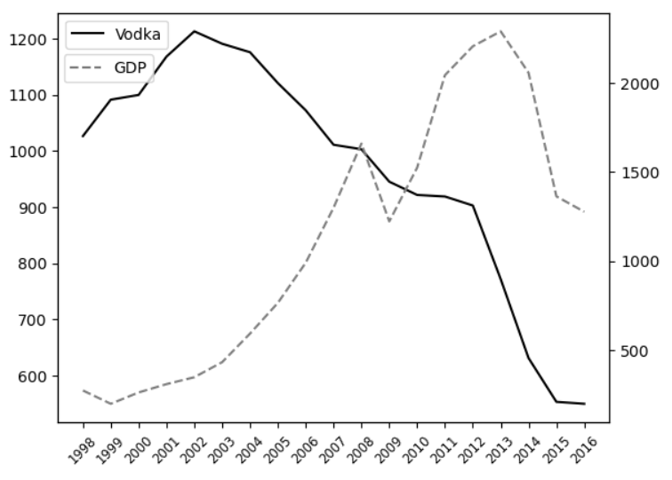
Economic Factors – GDP and Consumption by Type
Vodka Consumption (L)
GDP in $Billions
Year

Slide 9
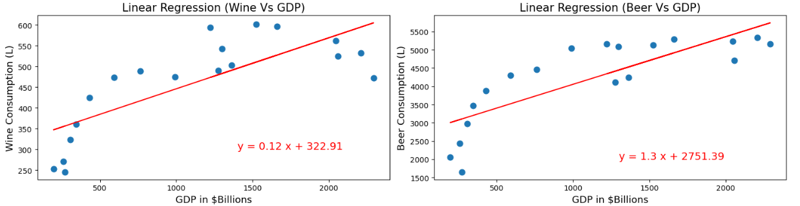
Modeling – Linear Regression on GDP and Consumption by Type
R = 0.77
R = 0.81

Slide 10
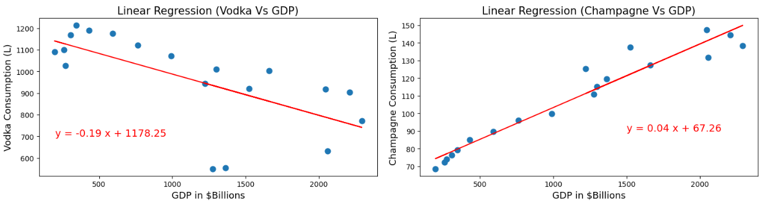
Modeling – Linear Regression on GDP and Consumption by Type
R = -0.66
R = 0.97

Slide 11
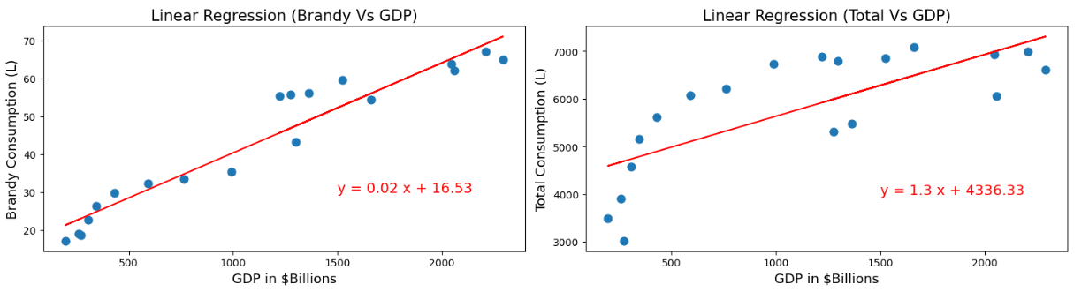
Modeling – Linear Regression on GDP and Consumption by Type
R = 0.96
R = 0.74

Slide 12
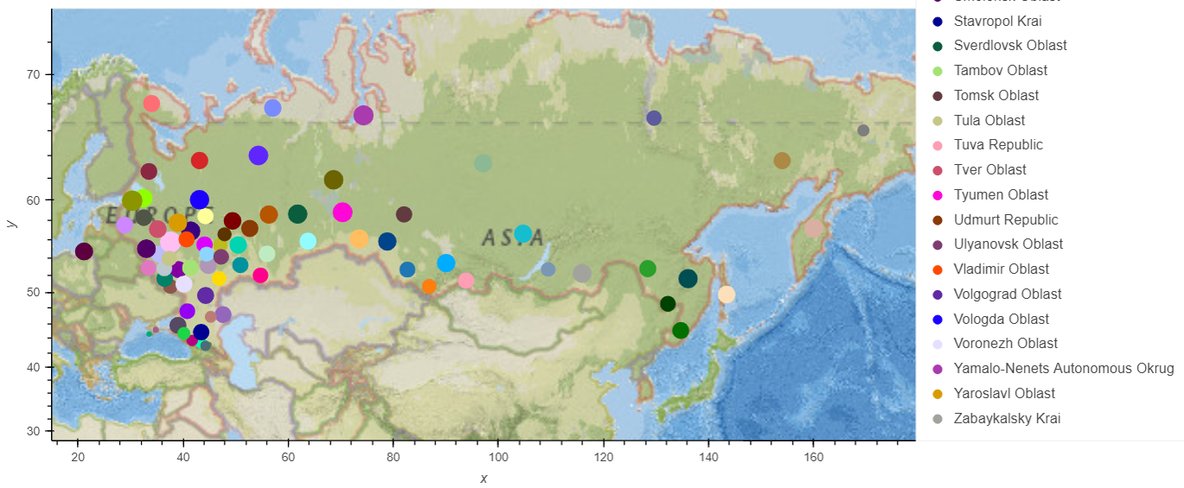
Total Consumption per Capita by Region

Slide 13
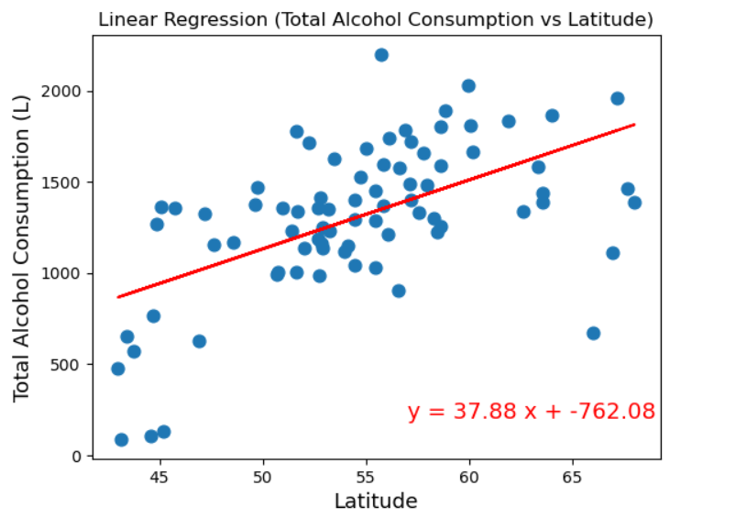
Modeling – Linear Regression on Total Alcohol Consumption vs Region Latitude
R = 0.56

Slide 14
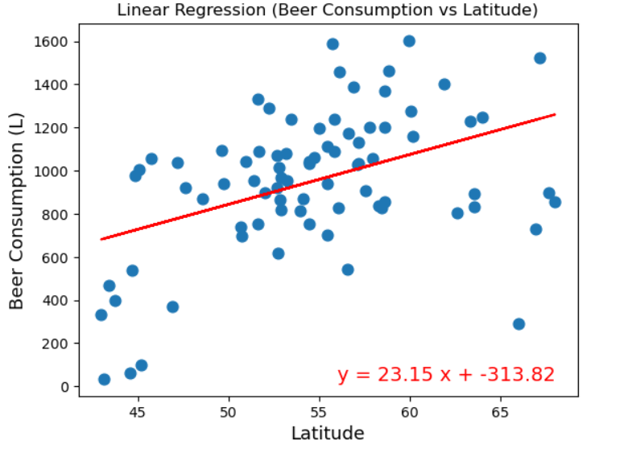
Modeling – Linear Regression on Beer Consumption vs Region Latitude
R = 0.43

Slide 15
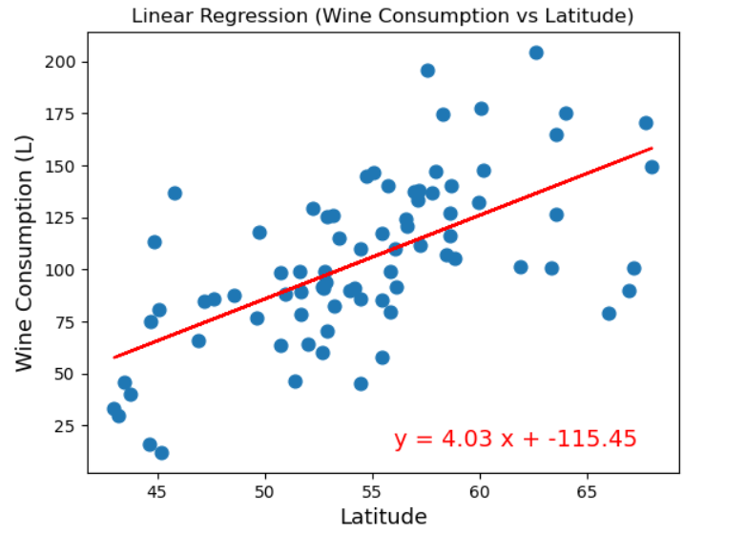
Modeling – Linear Regression on Wine Consumption vs Region Latitude
R = 0.62

Slide 16
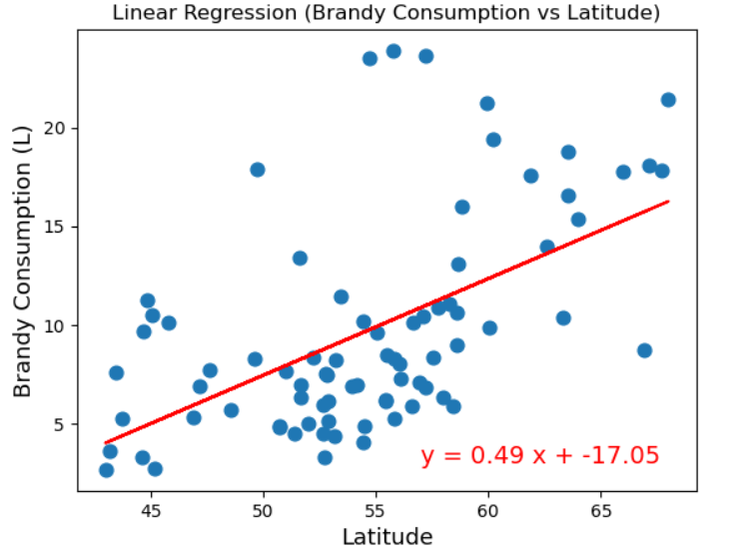
Modeling – Linear Regression on Brandy Consumption vs Region Latitude
R = 0.56

Slide 17
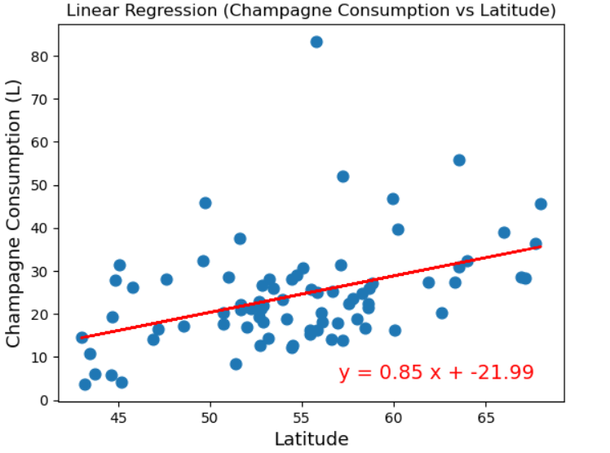
Modeling – Linear Regression on Champagne Consumption vs Region Latitude
R = 0.42

Slide 18
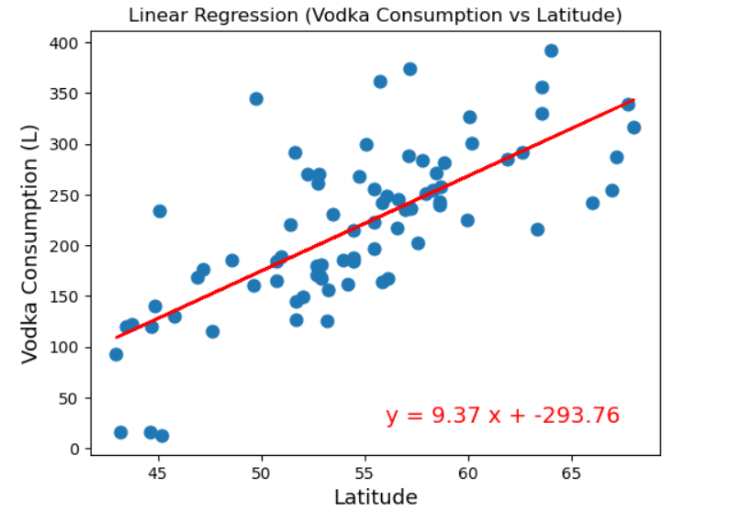
Modeling – Linear Regression on Vodka Consumption vs Region Latitude
R = 0.72

Slide 19
Conclusions
Most consumed alcohol in Russia?
Beer by total volume, vodka by volume of alcohol
Does per capita consumption vary with region latitude?
There are strong correlations suggesting that regions in higher latitudes consume more alcohol per capita… especially in the case of Vodka!
Can we predict consumption trends based on economic conditions?
Based on our linear regressions, we are confident that total alcohol consumption will increase in Russia during times of economic gain. However, evidence suggests that Vodka is being phased out by the other alcohol types (beer, wine, champagne, and brandy).

Slide 20

Thank you!
Questions?
Pour Decisions

